Slide 1

Department of Computer Science and Engineering
Leveraging Operational and Environmental Data for Train Delay Prediction via Deep Learning Models
PRESENTED BY
Kotha Lahari (22471A05N0)
Appala Chandana Priya (22471A05L2)
Yarroju Rekha Sri (23475A0502)
Under the Guidance of,
Dr.Rama Krishna Eluri M.Tech.,Ph.D,
Assistant Professor,
Department of Computer Science and Engineering,
Narasaraopeta Engineering College (Autonomous), Narasaraopet- 522 601.
Review No.
Department of CSE

Slide 2
OUTLINE
Abstract
Introduction
Literature Survey
Research Gaps
Problem Statement
Objectives
Block Diagram / Flow Diagram
Methodology
Implementation
Results and Analysis
Conclusion & Future Scope
References
Question and Answers
Acknowledgements
Department of CSE

Slide 3
ABSTRACT
The study focuses on predicting train delays using advanced deep learning techniques to enhance railway operational efficiency, improve passenger satisfaction, and support intelligent traffic management systems. Railway delays are complex phenomena influenced by multiple interrelated operational, environmental, and temporal factors. To address this challenge, a comprehensive dataset was utilized, incorporating both static and dynamic attributes such as station-to-station distance, weather conditions, day of the week, train type, time slot, route congestion level, and historical delay patterns. These diverse features enable the model to capture spatial, temporal, and contextual dependencies that significantly affect delay propagation. This project introduces a robust deep learning-based framework for accurate train delay prediction. Four state-of-the-art deep learning models—Deep Neural Network (DNN), Convolutional Neural Network (CNN), Long Short-Term Memory (LSTM), and Bidirectional Long Short-Term Memory (BiLSTM) were implemented and comparatively evaluated. Each model leverages unique architectural strengths: DNN captures nonlinear feature interactions, CNN extracts localized spatial patterns, LSTM models sequential temporal dependencies, and BiLSTM enhances learning by considering both past and future contextual information within time-series data.
.
Department of CSE

Slide 4
ABSTRACT
Extensive data preprocessing was performed to ensure consistency and reliability. The dataset was cleaned to handle missing and inconsistent values, categorical variables were encoded, and numerical features were normalized using standard scaling techniques. Time-related attributes were transformed into machine-readable numerical formats. The dataset was then split into training and testing sets to evaluate generalization capability and prevent overfitting.
Experimental evaluation was conducted using multiple performance metrics, including Coefficient of Determination (R²), Mean Absolute Error (MAE), Root Mean Square Error (RMSE), and Symmetric Mean Absolute Percentage Error (sMAPE). These metrics provide a comprehensive assessment of predictive accuracy, error magnitude, and model robustness. Results demonstrate that sequential models, particularly BiLSTM, achieved superior performance due to their ability to capture bidirectional temporal relationships in delay patterns. The proposed system demonstrates strong potential for real-time railway delay forecasting and intelligent decision support. By integrating such predictive models into railway control centers, passenger information systems, and smart transportation dashboards, operators can proactively manage congestion, optimize scheduling, and minimize cascading delays.

Slide 5
INTRODUCTION
Brief Introduction to the Project
Railway transportation plays a crucial role in supporting economic growth, daily commuting, and long-distance travel. However, train delays remain one of the most persistent challenges in railway operations, affecting millions of passengers and disrupting overall network efficiency. This project focuses on predicting train delays using advanced deep learning techniques applied to operational and environmental railway data.The study utilizes a structured dataset containing multiple influencing factors such as station-to-station distance, weather conditions, day of the week, time slot, train type, congestion level, and historical delay patterns. Since train delays exhibit strong temporal dependencies and nonlinear relationships among variables, deep learning models are well-suited for capturing these complex patterns.To identify the most effective predictive approach, four deep learning models Deep Neural Network (DNN), Convolutional Neural Network (CNN), Long Short-Term Memory (LSTM), and Bidirectional Long Short-Term Memory (BiLSTM)—were implemented and compared. Each model was trained and evaluated using standard performance metrics such as R², MAE, RMSE, and sMAPE. Among them, the BiLSTM model achieved the best results, demonstrating superior ability to capture bidirectional temporal dependencies in time-series data. The findings highlight its effectiveness for real-time delay forecasting and intelligent railway system management.
Department of CSE

Slide 6
INTRODUCTION
Motivation Behind the Project
Train delays are a frequent and unavoidable issue in many railway networks, especially in densely populated countries. These delays lead to missed connections, passenger dissatisfaction, increased operational costs, and inefficient resource utilization. Managing such disruptions manually or using traditional statistical prediction techniques often results in inaccurate forecasts due to the complex and dynamic nature of railway systems.
Traditional machine learning and rule-based approaches struggle to handle multiple interacting factors such as changing weather conditions, congestion levels, operational variations, and historical delay propagation. With the rapid advancement of artificial intelligence, deep learning models—particularly LSTM and BiLSTM have shown remarkable success in handling sequential and time-dependent data.
This project is motivated by the need to develop a more accurate, scalable, and intelligent delay prediction system that can assist railway authorities in proactive decision-making. By leveraging deep learning, the system aims to move from reactive delay management to predictive and preventive railway operations.

Slide 7
INTRODUCTION
Importance and Relevance
Accurate train delay prediction offers significant practical and societal benefits. For passengers, it improves travel planning, reduces uncertainty, and enhances overall satisfaction by providing timely and reliable information. Real-time predictions can help travelers adjust schedules, plan alternative routes, and avoid inconvenience.
For railway authorities, predictive analytics enables better schedule optimization, congestion control, resource allocation, and incident management. It reduces operational inefficiencies, minimizes cascading delays across interconnected routes, and supports data-driven decision-making.
The project is highly relevant in the era of smart transportation and smart cities. Integrating deep learning-based prediction systems into railway networks contributes to intelligent transport systems (ITS), sustainable mobility solutions, and digital transformation in public infrastructure. By combining advanced AI techniques with railway operational data, this work helps build smarter, more efficient, and more reliable railway systems for the future.

Slide 8
LITERATURE SURVEY
No | Title | Author | Journal Name & Year | Methodology Adapted | Key Findings | Gaps
1 | Heterogeneous Machine Learning Ensembles for Predicting Train Delays | Mostafa Al Ghamdi, Gerard Parr, Wenjia Wang; 2023; IEEE Transactions on Intelligent Transportation Systems | https://ueaeprints.uea.ac.uk/id/eprint/94109/1/IEEE_Paper_PublishedVersion.pdf?utm_source=chatgpt.com | Remove duplicates and missing records. Logical validation , Feature engineering | Heterogeneous ensembles outperformed single and homogeneous models, with MSM1 showing the best performance and strong generalization on a separate dataset. | Lack of suitable diversity metrics for Regression tasks. - Computational cost of training and evaluating multiple Ensemble combinations
2 | Short-term origin–destination flow prediction for urban rail network: a deep learning method based on multi-source big data | Hongmeng Cui, Bingfeng Si, Jiayuan Wang, Ben Zhao, Weiting Pan (2024), Springer – Complex & Intelligent Systems | https://link.springer.com/article/10.1007/s40747-024-01391-6 | Min–max normalization - Stratified OD sampling - Clustering operational days via improved K-means | ST-LSTM effectively handles OD flow issues and achieves superior performance over ARIMA, SVR, RNN, LSTM, ConvLSTM, and NAR in RMSE, MAE, and MAPE. | Does not model dynamic external disruptions (e.g. weather, accidents) - Not validated on metro systems outside China
3 | Modelling Railway Delay Propagation as Diffusion-Like Spreading | Mark M. Dekker et al., 2022, EPJ Data Science (SpringerOpen) | https://epjdatascience.springeropen.com/articles/10.1140/epjds/s13688-022-00359-1 | Network reconstruction,removal of outlier trains, interpolation for skipped intermediate stations, clustering using K-means on geographical data | The novel diffusion model efficiently captures system-wide delay propagation, with optimal performance achieved through proper spatial aggregation. | Model assumes no new delay generation, ignores train-level discrete behaviors, and assumes full delay transfer to next station; lacks fine-grained detail
4 | Prediction of High-Speed Train Delay Propagation Based on Causal Text Information | Qianyi Liu, Shengjie Wang, Zhongcan Li, Li Li, Jun Zhang, Chao Wen (2022), Springer (Railway Engineering Science | https://link.springer.com/article/10.1007/s40534-022-00286-x | Chinese text segmentation with Jieba, stopword removal (Harbin, Baidu, SCU lists), text regularization | Integrating delay cause text with operating environment data enhances prediction accuracy, with the XGBoost + CBOW + Mean model achieving the best accuracy of 84% within a 3-minute margin. | Lack of deep semantic embedding models due to small dataset; limited use of deep learning (CNN, LSTM not yet applied); corpus size can be increased
5 | Quantifying the dynamic predictability of train delay with uncertainty-aware neural networks | Thomas Spanninger, Nina Wiedemann, Francesco Corman; 2024; Transportation Research Part C, Elsevier | https://www.sciencedirect.com/science/article/pii/S0968090X24000846?via%3Dihub | Minimal missing data handling,Categorized trains as fast/slow,Generated prediction intervals at each operational point | UANN achieves superior accuracy over Markov chains, Bayesian networks, and NGBoost, while train delay predictability declines exponentially as aleatoric uncertainty increases with time. | Lack of generalizability to systems with different train dynamics - Limited improvement from added contextual features
Department of CSE

Slide 9
LITERATURE SURVEY
No | Title | Author | Journal Name & Year | Methodoloy Adapted | Key Findings | Gaps
6 | Real-Time Passenger Train Delay Prediction Using Machine Learning: A Case Study With Amtrak Passenger Train Routes | Pipatphon Lapamonpinyo, Sybil Derrible, Francesco Corman, 2022, IEEE Open Journal of Intelligent Transportation Systems | https://ieeexplore.ieee.org/stamp/stamp.jsp?tp=&arnumber=9846898 | Linear Regression (baseline), Random Forest, Gradient Boosting Machine, Multi-layer Perceptron (MLP) | MLP + RWH-DFS had best performance (R² ~0.62); external features like historical delay, ridership, and weather improved accuracy by 5.2% | ASMAD, Weather Underground, MDOT, ACS
7 | Data-driven insights to reduce uncertainty from disruptive events in passenger railways | Luis Marques, Sergio Moro, Pedro Ramos; Accepted Nov 2024, Published 2025; Public Transport (Springer) | https://link.springer.com/article/10.1007/s12469-024-00380-9 | Neural Networks: MLP, CNN, RNN- Tree-Based: Random Forest (RF), Extra Trees (RF‑Extra)- Evaluation: MAE, RMSE, MSE, Accuracy, ROC AUC | NN and RNN models work best on small datasets,RF and MLP models are superior on large datasets,Feature engineering improves generalization,introduced new attributes like infrastructure, emonstrated the impact of preprocessing on modelperformance | Dataset is country-specific (Portugal); generalizability to other systems needs validation COVID-affected data for 2021–2022 was imputed Limited discussion of real-time deployment and latency handling
8 | A Review of Passenger-Oriented Railway Rescheduling Approaches | Bishal Sharma, Paola Pellegrini, Joaquin Rodriguez, Neeraj Chaudhary; 2023; European Transport Research Review, Springer) | https://etrr.springeropen.com/articles/10.1186/s12544-023-00587-0 | reviews a variety of approaches: Exact methods: IP, MIP, AG (Alternative Graph).Heuristics: FRFS, FSFS, Tabu Search, Greedy.Metaheuristics: Genetic Algorithms, ALNS, VNSr | First comprehensive review to focus entirely on passenger-oriented railway rescheduling. Identifies 26 conventional and 11 urban approaches.Highlights the lack of models that handle real-time passenger flow, behavior, and platform reassignments. | Limited research on microscopic models that consider passengers.No current models include rerouting with platform assignment changes under passenger constraints.Lack of modeling of passenger decisions in real-time.
9 | How Complex Systems Sometimes Follow Murphy’s Law: Train Delay Prediction at a Station Using Delays at Previous Stops as the Features | Pranjal Mandhaniya, Nils O.E. Olsson, Anders S. Larsen, Caroline Skjøren; 2024, Elsevier (Procedia Computer Science) | https://doi.org/10.1016/j.procs.2024.06.357 | Recurrent Neural Network (RNN), Gated Recurrent Unit (GRU), Long Short-Term Memory (LSTM) | LSTM model gave the best convergence; adding too many features degraded performance; maximum R² = 0.81; delay patterns align with customer behavior. | Over-engineering features reduces model accuracy; predicted delays had narrower ranges than actual; early departure events affect accuracy
10 | Route Choice Estimation in Rail Transit Systems Using Smart Card Data: Handling Vehicle Schedule and Walking Time Uncertainties | Thomas James Tiam-Lee and Rui Henriques, 2022, Springer (European Transport Research Review) | https://doi.org/10.1186/s12544‑022‑00558‑x | Likelihood estimation via time deviation scores; candidate route simulation using inferred train timings (Algorithm 1) | Robust method for predicting individual passenger routes without using precise timetables; reveals true rider preferences (least transfers vs. least stations) | Cannot infer exact personal factors influencing route choice; lacks ground-truth validation; performance affected by incomplete entry-exit records

Slide 10
RESEARCH GAPS
1.Lack of Integration with Smart Systems
Existing approaches are not fully aligned with intelligent transportation frameworks or smart city infrastructure for real-world applications.
2. Limited Dataset Diversity
Most research uses region-specific or small datasets, reducing the generalizability and robustness of models across different railway systems.
3. Lack of Real-Time Predictive Frameworks
Many studies focus on offline delay prediction rather than developing models suitable for real-time forecasting and dynamic decision-making.
4. Insufficient Use of Sequential Context
Traditional models often fail to capture long-term temporal dependencies and bidirectional relationships in train delay sequences.
5. Temporal Drift and Seasonal Variations
Existing deep learning models often act as “black boxes,” providing limited insights into which features (e.g., weather, congestion) most influence delay predictions.
Department of CSE

Slide 11
RESEARCH GAPS
6.Limited Multimodal Data Integration Most existing studies do not integrate heterogeneous data sources such as IoT sensors, GPS tracking, real-time traffic feeds, weather APIs, and maintenance logs into a unified predictive framework.
7.Scalability and Deployment Challenges Many proposed models are not evaluated for scalability or deployment in large-scale national railway networks with high-frequency data streams.
8. Computational Efficiency Constraints High-performing deep learning models often require significant computational resources, making real-time implementation difficult in resource-constrained environments.
9. Imbalanced and Noisy Data Handling Train delay datasets frequently contain imbalanced delay distributions and noisy records, yet many studies do not apply robust techniques to handle these challenges effectively.
10. Lack of Explainability and Interpretability Deep learning models often function as “black boxes,” offering limited transparency regarding how input features influence delay predictions, which reduces trust and practical adoption.

Slide 12
PROBLEM STATEMENT
Inefficiency of Traditional Models
Conventional machine learning and statistical models fail to effectively capture complex non-linear relationships and long-term dependencies present in railway operational data.
Integration Gap with Smart Transportation Systems
Existing research does not sufficiently bridge predictive modeling with intelligent railway management systems for automated scheduling and passenger information.
Insufficient Use of Multidimensional Data
Current studies often overlook important operational and environmental parameters (like time of day, station distance, and route congestion) that significantly affect delay prediction.
Limited Comparative Analysis
There is a lack of comprehensive evaluation among different deep learning architectures (DNN, CNN, LSTM, BiLSTM) under uniform experimental conditions.
High Computational Cost
Advanced models like BiLSTM, though accurate, often demand high training time and computational power, making deployment in real-time systems difficult.
Department of CSE

Slide 13
PROBLEM STATEMENT
Lack of Real-Time Adaptive Learning Most existing models are trained offline and do not adapt dynamically to changing railway conditions, seasonal variations, or sudden disruptions.
Limited Handling of Delay Propagation Effects Current approaches often predict delays for individual trains without modeling how delays propagate across interconnected routes and stations.
Scalability Constraints Many proposed systems are tested on small or simulated datasets and are not validated for large-scale national railway networks.
Inadequate Feature Engineering Strategies Some studies rely solely on raw features without exploring engineered attributes that could enhance predictive accuracy and generalization.
Lack of Multisource Data Fusion Few models integrate real-time data streams such as IoT sensors, GPS tracking, maintenance logs, and live traffic updates into a unified framework.
Minimal Focus on Resource Optimization Prediction results are rarely linked with optimization mechanisms for automated rescheduling, crew allocation, or congestion management.

Slide 14
OBJECTIVES
To develop a Deep Learning Model for accurate and efficient Train Delay Prediction.
Specific Objectives
To develop a deep learning framework for accurate prediction of train delays using operational and environmental railway data.
To preprocess and construct a comprehensive dataset that includes time-related, operational, and contextual factors such as weather, distance, congestion, and historical delays.
To compare multiple deep learning architectures—DNN, CNN, LSTM, and BiLSTM—for identifying the most effective model for train delay forecasting.
To evaluate the models’ performance using key statistical metrics like RMSE, MAE, R², and sMAPE for a fair and detailed comparison.
To analyze the temporal and spatial dependencies in delay data and determine how bidirectional sequence learning (BiLSTM) improves predictive accuracy.
To contribute toward the development of intelligent railway systems by enhancing real-time scheduling, passenger alerting, and traffic management through predictive analytics.
Department of CSE

Slide 15
OBJECTIVES
To design a scalable and modular prediction framework that can be integrated with real-time railway management and decision-support systems.
To investigate the impact of feature engineering and preprocessing techniques (encoding, normalization, time transformation) on overall model performance and generalization.
To analyze the computational efficiency and training time of different deep learning models to evaluate their feasibility for real-time deployment.
To study the influence of key operational and environmental factors (e.g., weather, congestion, distance) on delay prediction accuracy.
To examine delay propagation patterns across routes and stations to better understand sequential dependencies in railway networks.
To improve model robustness by ensuring proper data splitting, validation techniques, and prevention of overfitting.

Slide 16
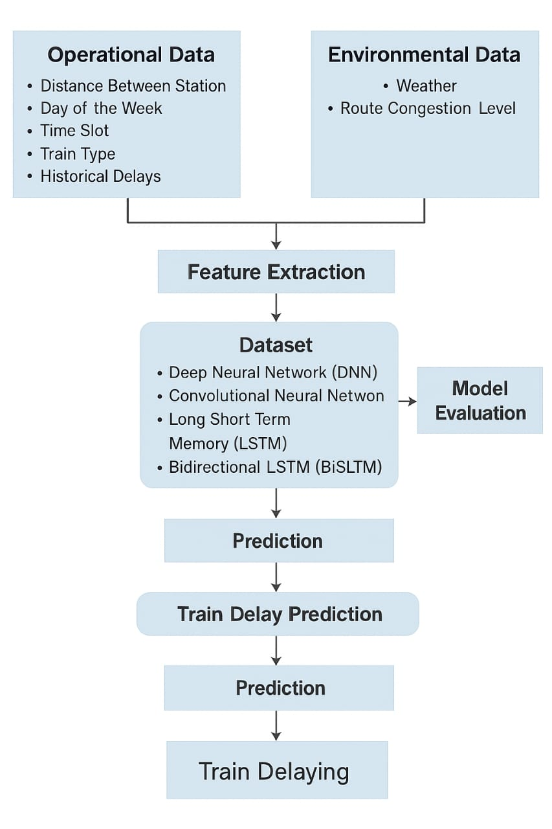
BLOCK DIAGRAM OR FLOW DIAGRAM
Department of CSE

Slide 17
METHODOLOGY
Methods and Approaches
Preprocessing
Data Cleaning and Handling MissingValues:Removed null, inconsistent, and duplicate records to ensure data quality and reliability.
Feature Encoding and Transformation:Converted categorical variables (e.g., train type, station, day) into numerical form and transformed time fields (arrival/departure) into minutes for uniform representation.
Feature Scaling and Data Splitting:Normalized numerical features using StandardScaler to improve model performance and divided the dataset into 80% training and 20% testing sets for balanced evaluation.
3. Model Framework
The model framework uses four deep learning architectures — DNN, CNN, LSTM, and BiLSTM — to predict train delays from operational and environmental data.
Each model captures different data patterns: DNN for non-linear relations, CNN for spatial features, and LSTM/BiLSTM for temporal dependencies.
Among them, BiLSTM delivers the best performance with superior accuracy in real-time delay prediction.
2. Exploratory Data Analysis (EDA)
Understanding Data Distribution:Analyzed key variables such as distance, weather, day of the week, train type, and congestion level, revealing that distance between stations and weather conditions significantly influence train delays.
Correlation and Feature Relationships:Used correlation plots and heatmaps to reveal positive relationships between route congestion, historical delays, and current delay times.
Pattern and Trend Analysis:Visualized delay patterns showing peak delays during morning and evening hours on specific weekdays, with rainy weather contributing to higher delay values.
4. Algorithms & Training
The models were trained using the Adam optimizer with Mean Squared Error (MSE) as the loss function.
Dropout layers were applied to prevent overfitting and improve generalization.
Each model DNN, CNN, LSTM, and BiLSTM was trained on an train-test split, and performance was evaluated using R², MAE, RMSE, and sMAPE metrics.
Department of CSE

Slide 18
IMPLEMENTATION
Implementation:
Built on Google Colab (Python) using kaggle dataset(train delay data.csv). The project implements a rail transit delay prediction model using Deep learning techniques. It processes railway operational data, performs feature engineering, and trains models to predict train delays based on multiple factors like station, time, and weather.
Software Specs:
Operating System: Windows / Linux / macOS
Programming Language: Python 3.8+
Libraries: NumPy, Pandas,
Scikit-learn, Matplotlib, Seaborn
Development Environment:
Jupyter Notebook or Google Colab
Hardware Specs:
Processor: Intel Core i5 or higher
RAM: 8 GB or more
Storage: Minimum 2 GB free space
GPU: NVIDIA CUDA-enabled GPU for faster model training
Challenges & Solutions:
Challenge1: Missing and inconsistent data affected model accuracy.
Solution: Applied data cleaning, encoding, and normalization techniques.
Challenge2: Model overfitting and low accuracy during testing.
Solution: Used cross-validation, parameter tuning, and Colab GPU for efficient training.
Department of CSE

Slide 19
Comparison Table
Limitations in Base Paper | How Proposed Paper Overcomes Them
Used traditional ML models (RF, XGBoost, SVR) with limited sequential learning. Limited ability to capture long-term temporal dependencies. No bidirectional sequence modelling Limited feature exploration Basic preprocessing techniques Evaluation focused on fewer metrics Lower prediction accuracy (~94–95%) Limited focus on real-time smart railway systems Less emphasis on deep temporal analysis | Implemented advanced Deep Learning models (DNN, CNN, LSTM, BiLSTM). LSTM and BiLSTM effectively capture long-term and bidirectional sequence patterns Introduced BiLSTM for forward and backward dependency learning Added enriched features like weather, congestion, time-slot, and historical delays Applied detailed preprocessing including encoding, normalization, and feature construction Used multiple metrics: R², MAE, RMSE, and sMAPE for comprehensive comparison Achieved higher accuracy (96.17% R²) Designed framework supporting intelligent transport and smart city integration Strong sequential modeling for improved delay pattern understanding

Slide 20
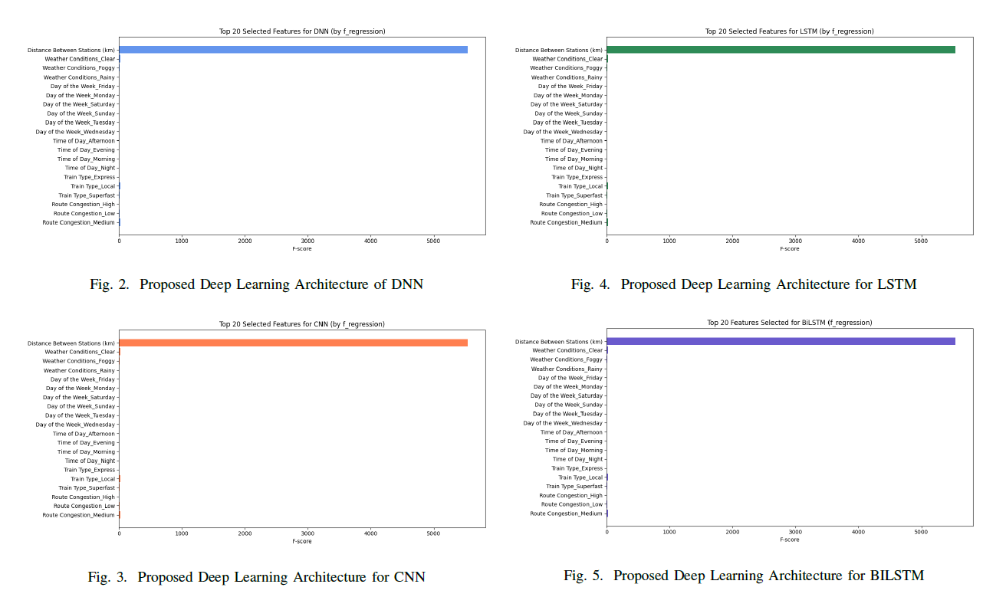
RESULTS & ANALYSIS
The feature importance graphs for DNN, CNN, LSTM, and BiLSTM models highlight the top 20 influential features affecting train delay prediction.
Across all models, the “Distance Between Stations (km)” emerged as the most dominant feature, followed by weather conditions (clear, foggy, rainy), day of the week, and time of day variables.
This analysis shows that both spatial (distance) and environmental (weather) factors play a major role in delay forecasting, confirming the models’ ability to capture real-world operational dependencies.
Among all, the BiLSTM model demonstrated superior feature sensitivity and learning depth, enabling it to achieve the highest prediction accuracy and lowest error rates across evaluation metrics.
Department of CSE

Slide 21
RESULTS & ANALYSIS
The bar chart compares the performance of CNN, LSTM, DNN, and BiLSTM models using key metrics — R² (%), MAE, RMSE, sMAPE (%), and CPU Time (s).
Among all models, BiLSTM achieved the highest R² (96.17%) and lowest RMSE (40.8) and MAE (28.42), indicating superior prediction accuracy and reliability.
Although BiLSTM required higher CPU time due to its dual-directional processing, it outperformed other models in precision and consistency, proving most effective for real-time train delay prediction.
Department of CSE

Slide 22
RESULTS & ANALYSIS
The comparison graph shows True vs Predicted train delays for the first 100 samples across all deep learning models DNN, CNN, LSTM, and BiLSTM.
All models closely follow the true delay trend, but BiLSTM predictions align most accurately with actual delay values, demonstrating its superior ability to capture bidirectional temporal dependencies.
The results confirm that BiLSTM achieves the highest R² score (96.17%) and lowest RMSE (40.8), outperforming other models in accuracy and consistency for real-time train delay prediction.
Department of CSE

Slide 23
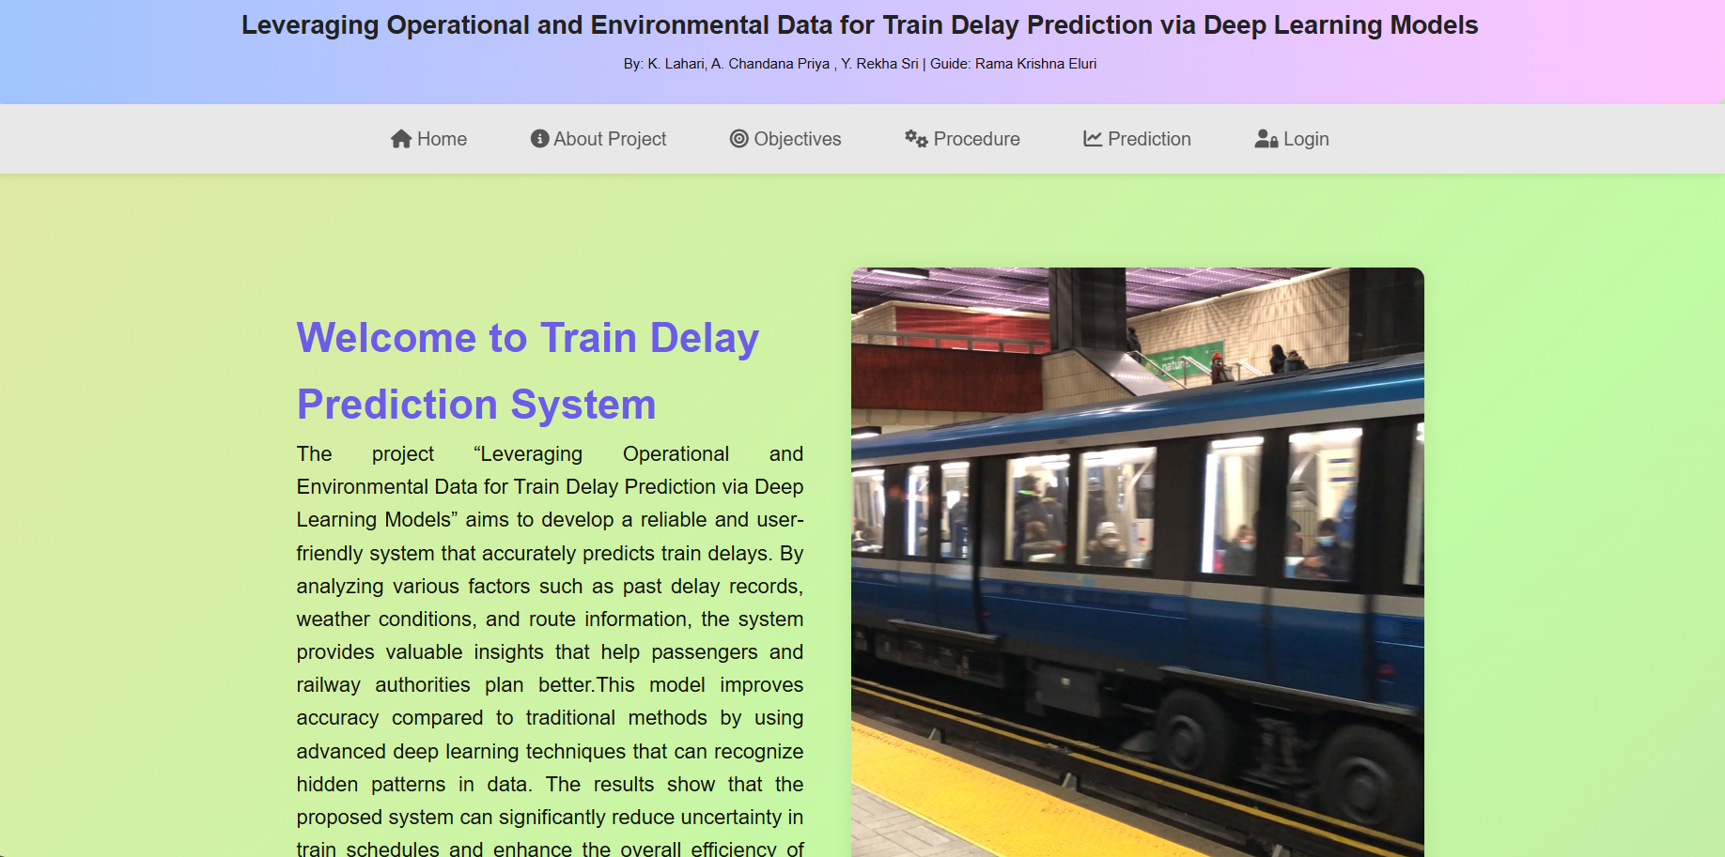
Output Screens
Fig:Home Page

Slide 24
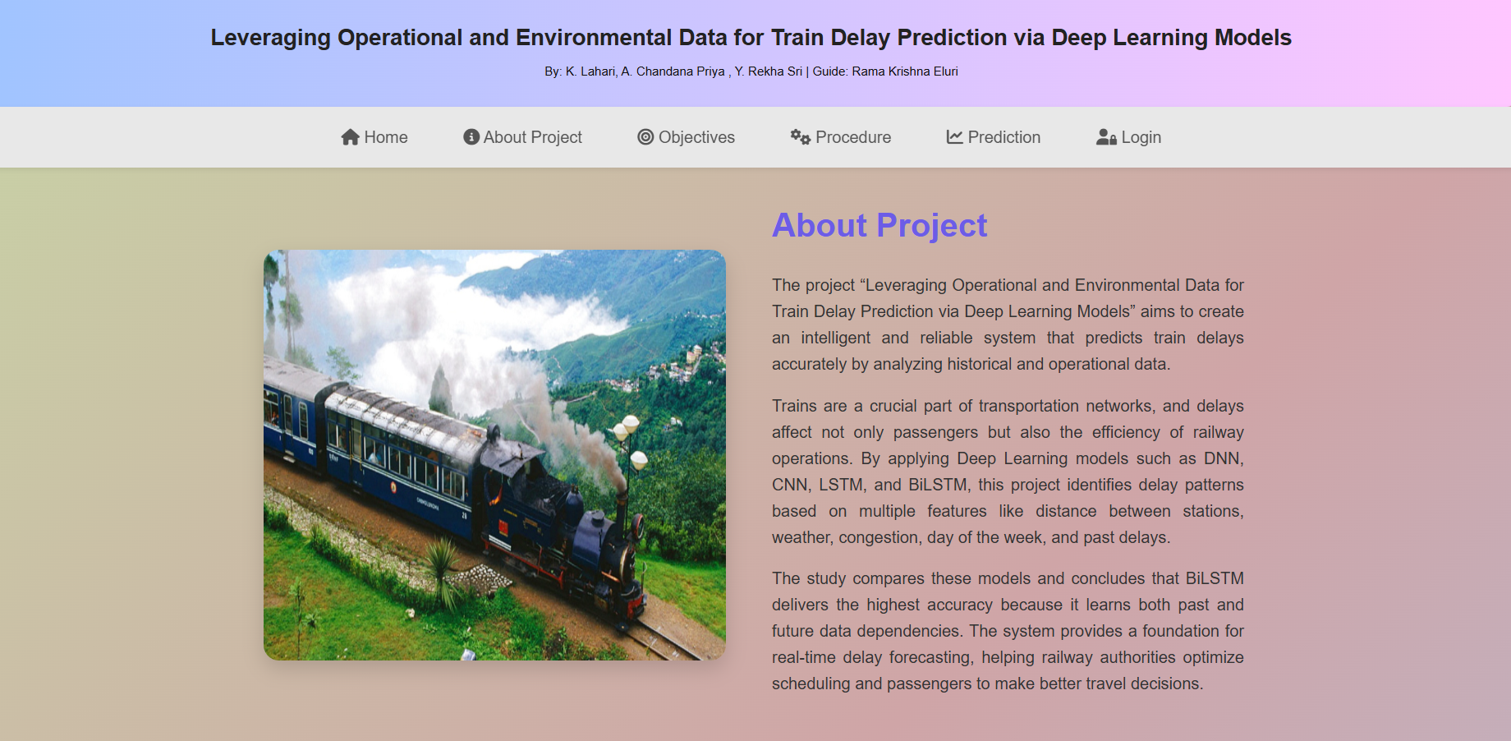
Output Screens
Fig:About Page

Slide 25
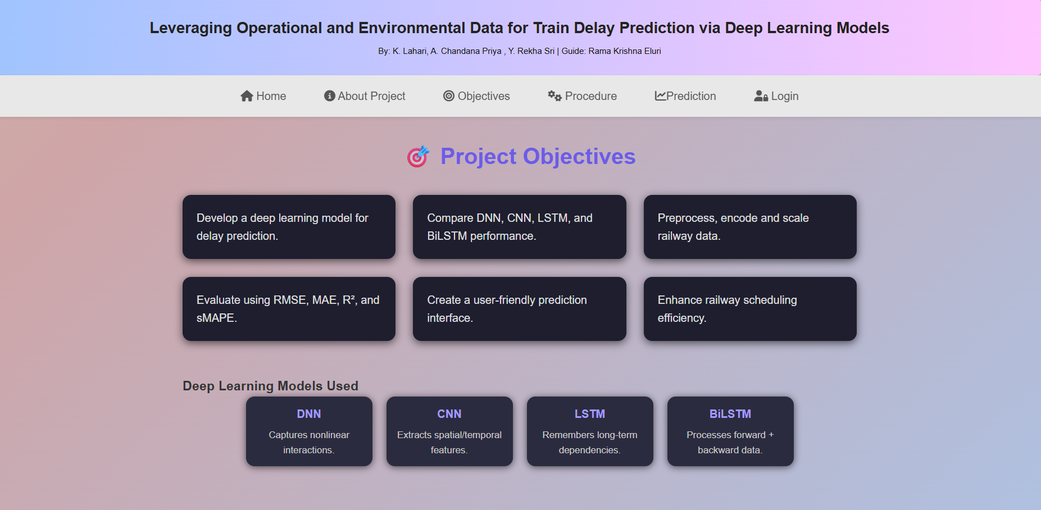
Output Screens
.
Fig:Objectives Page

Slide 26
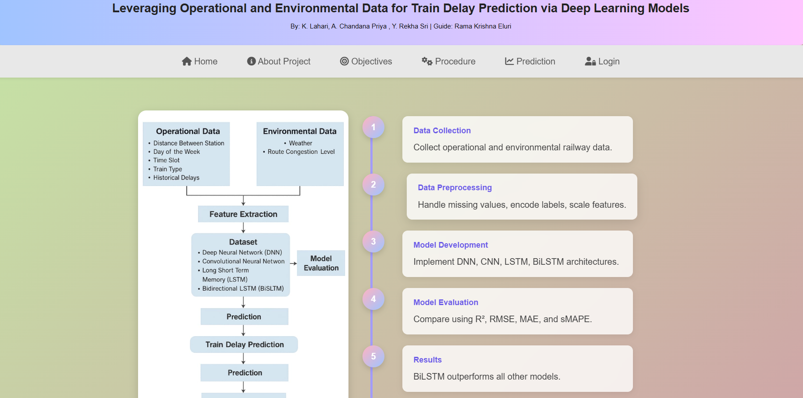
Output Screens
Fig:Procedure Page

Slide 27
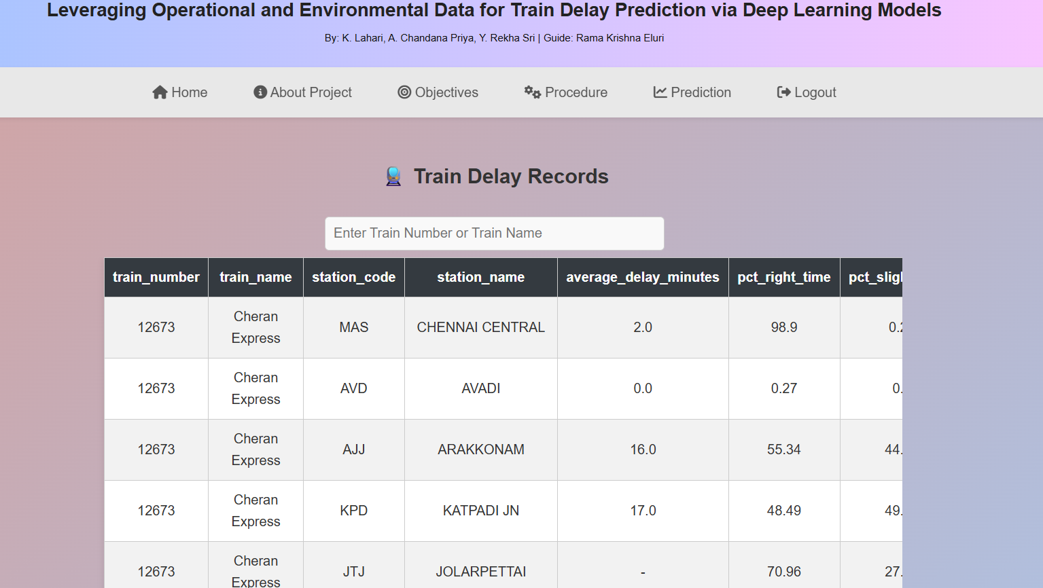
Output Screens
Fig:Prediction Page

Slide 28
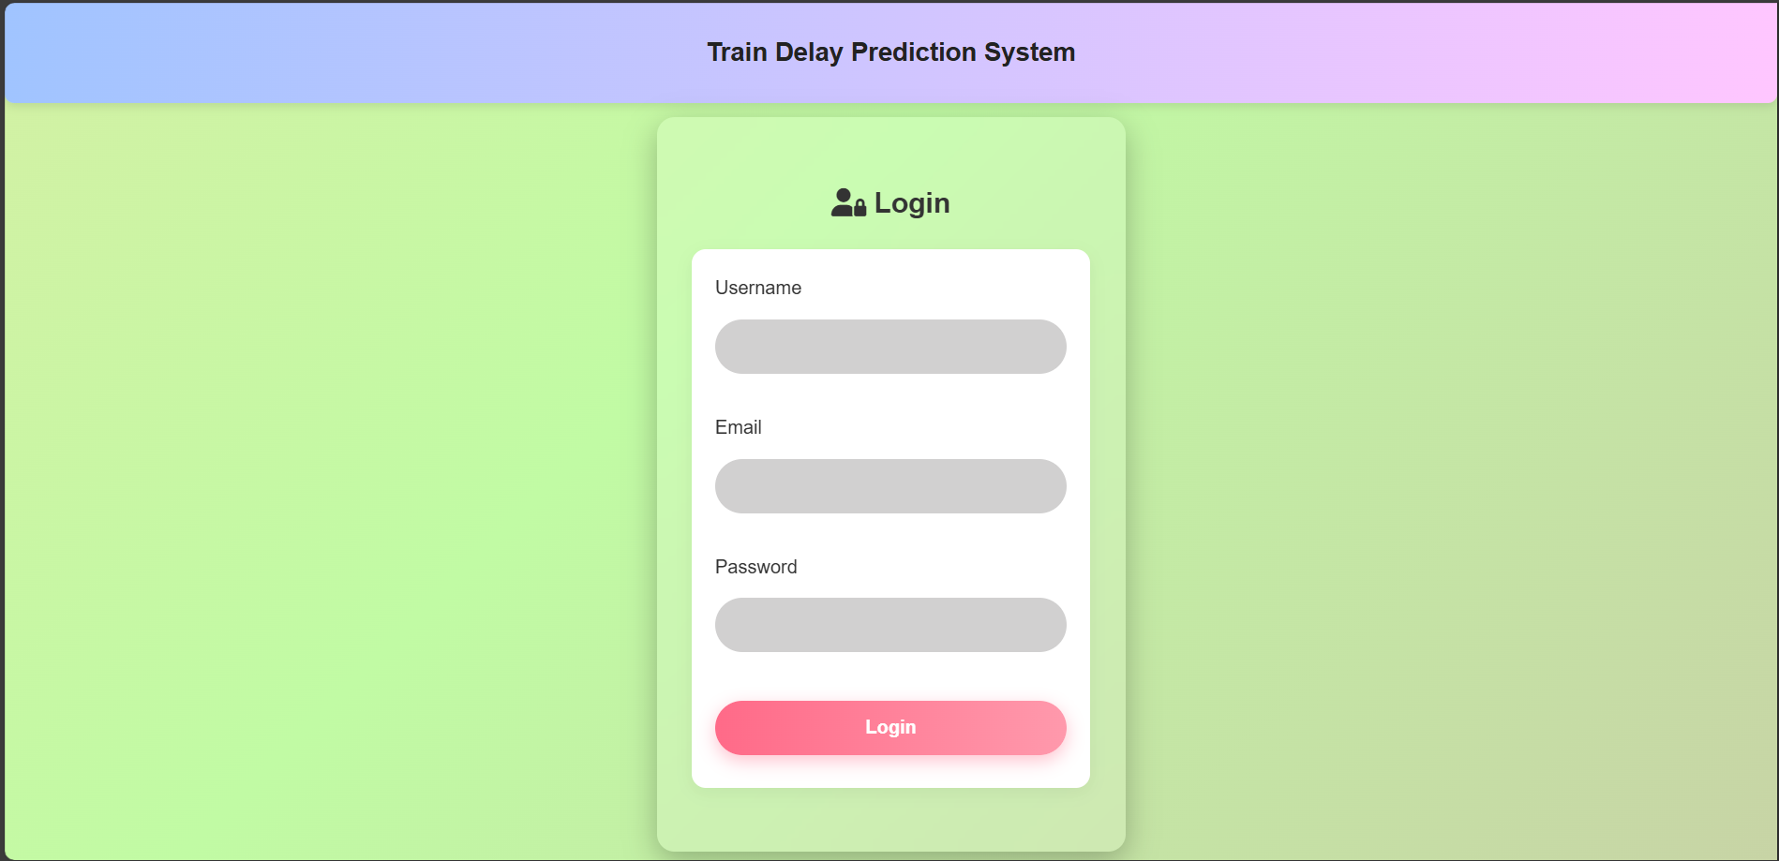
Output Screens
Fig:Login Page

Slide 29
CONCLUSION and FUTURE SCOPE
Key Findings
BiLSTM outperformed all other models (DNN, CNN, LSTM) with the highest accuracy (R² = 96.17%) and the lowest error values (RMSE = 40.8, MAE = 28.42).
The proposed framework achieved robust and consistent performance across all evaluation metrics RMSE, MAE, R², and sMAPE.
Although BiLSTM required higher computational time, it delivered superior predictive reliability, making it ideal for real-time forecasting.
Significance of Results
The results demonstrate that deep learning models, particularly BiLSTM, can accurately forecast train delays, improving the efficiency and reliability of railway operations.
The findings support the development of smart transportation systems, contributing to reduced passenger inconvenience and improved service quality.
Overall, the results establish a strong foundation for data-driven infrastructure planning and intelligent transport solutions in smart city initiatives.
Department of CSE

Slide 30
CONCLUSION and FUTURE SCOPE
Future Developments
Integrate real-time data sources like live weather and maintenance logs to improve prediction accuracy
Implement advanced models such as Transformers for better temporal understanding.
Extend the framework to multi-modal transport systems for smart city integration.
Limitations
Limited dataset scope and absence of real-time data affect generalization.
High computational demand of deep models like BiLSTM hinders real-time deployment.
Lack of model interpretability makes understanding feature impact difficult.
Department of CSE

Slide 31
REFERENCES
[1] K. Rautela, M. C. Trivedi, and P. P. Roy, "A BiLSTM based deep learning model for predicting train delays," in Proc. Int. Joint Conf.
Neural Netw. (IJCNN)*, Glasgow, UK, Jul. 2020, pp. 1-7.
[2] L. Ge, M. Sarhani, S. Vos, and L. Xie, "Review of transit data sources:Potentials, challenges and complementarity," Sustainability, vol. 13,no. 20, p. 11450, 2021.
[3] Z. Li, C. Wen, R. Hu, C. Xu, P. Huang, and X. Jiang, "Near-term train delay prediction in the Dutch railways network," Int. J. Rail Transportation, vol. 9, no. 6, pp. 520-539, 2020.
[4] N. Markovic, S. Milinkovic, K. S. Tikhonov, and P. Schonfeld, "Examiningpassenger train arrival delays with support vector regression,"Transportation Research Part C*, vol. 56, pp. 251-262, 2015.
[5] M. Sarhani and S. Vos, "On the effectiveness of SVM-based feature selection for transit delay prediction," 2021.
[6] J. Wessel, J. Allen, and K. Watkins, "Integrating real-time data into GTFS, a public transit data standard," *Transportation Research Record, vol. 2650, no. 1, pp. 110-118, 2017.
[7] P. Huang, C. Wen, L. Fu, et al, "Modeling train operation as sequences:A study of delay prediction with operation and weather data," *Transportation Research Part E*, vol. 141, p. 102022, 2020.
[8] M. Shoman, T. Laverty, and C. Andris, "Transit delay prediction using entity embeddings on heterogeneous data," *IEEE Trans. Intell. Transp.
Syst.*, vol. 22, no. 7, pp. 4151-4161, 2020.
Department of CSE

Slide 32
REFERENCES
[9]R. Al-Naim and Y. Lytkin, "Review and comparison of prediction algorithms for estimated time of arrival using geospatial transportation data," *Procedia Computer Science*, vol. 193, pp. 13-21, 2021.
[10] M. Sarhani and S. Vos, "Evaluation of regression algorithms for rail transit delay prediction using open data," *Public Transport*, vol. 15,no. 3, pp. 635-659, 2023. [Online].
Available: https://doi.org/10.1007/s12469-023-00300-9
[11] C. Wen, P. Huang, and L. Fu, "Predicting transit delays using graph attention networks," *Transportation Research Part C*, vol. 149, p.103935, 2023.
[12] X. Wang, L. Chen, and Y. Zhao, "Comparative study of machine learning models for metro delay forecasting," *Expert Syst. Appl.*, vol. 216, p.119419, 2023.
[13] Huang, P., Fu, L., Wen, C. (2024). Combining data sources for real-time delay prediction in urban rail systems. IEEE Transactions on Intelligent Transportation Systems, 25(1), 101–112.
[14] Godfrid, J., Radnic, P., Vaisman, A., Zimanyi, E. (2022). Examining public transport in the city of Buenos Aires with MobilityDB. Public Transport, 14(2), 287–321.
[15] M. S. Gudur, A. Parida, and S. Mishra, "Deep learning approach for train delay prediction using LSTM," *Transportation Research Record*, vol.2673, no. 11, pp. 373-381, 2019.
Department of CSE

Slide 33
ACKNOWLEGEMENTS
Thank You for Your Time and Attention!
We truly appreciate the support and guidance from our mentors and organizers,and we’re grateful to the audience for being part of our presentation journey. We look forward to your valuable feedback and questions on our project “Leveraging Operational and Environmental Data for Train Delay Prediction via Deep Learning Models”.
Department of CSE

Slide 34
QUESTIONS and ANSWERS
Thank You for Listening! – Presented by Team DG3
We truly value your time and interest in our work. We now welcome your questions, feedback, or insights on our study
💬 Let’s dive deeper into the model, dataset, or possible future developments!
Department of CSE

